Slide 1

Topic 2: Process & Threads
Operating System
Er. Nawaraj Bhandari

Slide 2
Process Concept
An operating system executes a variety of programs
batch systems - jobs
time-shared systems - user programs or tasks
job and program used interchangeably
Process - a program in execution
process execution proceeds in a sequential fashion
A process is an activity of some kind, it has program, input, output and state.

Slide 3
Process Model
Uni-programming
Multiprogramming
Multiprocessing

Slide 4
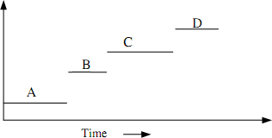
Uni-programming Model
Only one process at a time
Examples: Older systems
Advantages: Easier for OS designer
Disadvantages: Not convenient for user and poor
performance

Slide 5
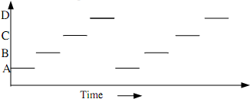
Multiprogramming Mode
multiple process at a time
OS requirements for multiprogramming:
Policy: to determine which process is to schedule.
Mechanism: to switch between the processes.
Examples: Unix, WindowsNT
Advantages: Better system performance and user convenience.
Disadvantages: Complexity in OS

Slide 6
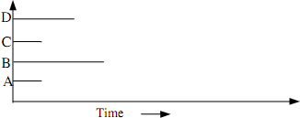
Multiprocessing Model
System with multiple processor
Distributed OS and Network OS

Slide 7
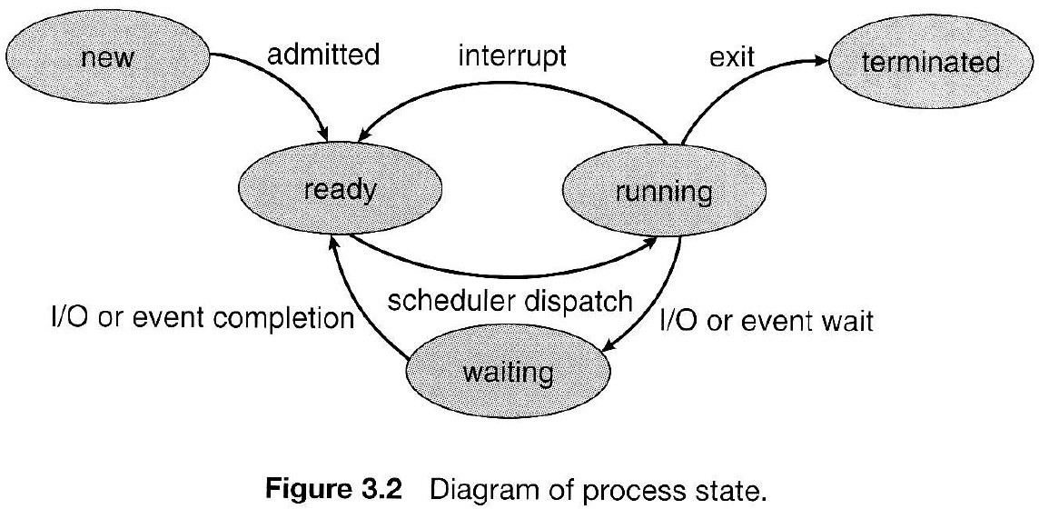
Process States diagram
Figure 3.2

Slide 8
Process States
New - The process is being created.
Running - Instructions are being executed.
Waiting - Waiting for some event to occur.
Ready - Waiting to be assigned to a processor.
Terminated - Process has finished execution.

Slide 9
Process Control Block
Process must be saved when the process is switched from one state to another so that it can be restarted later as it had never been stopped.
The PCB is the data structure containing certain important information about the process -also called process table or processor descriptor.
Process state: running, ready, blocked.
Program counter: Address of next instruction for the process.
Registers: Stack pointer, accumulator, PSW etc.
Scheduling information: Process priority, pointer to scheduling queue
etc.
Memory-allocation: value of base and limit register, page table, segment table etc.
Accounting information: time limit, process numbers etc.
Status information: list of I/O devices, list of open files etc.

Slide 10
PCB
The PCB simply serves as repository of any information that may vary from process to process.
Pointer | Process state
Process number
Program counter
Registers
Memory Limits
List of open files
…….

Slide 11
Operation on process
The processes in the system can execute concurrently, and they must be create and deleted by dynamically.
provide the creation and
mechanism for process termination.
Process Creation.
Process Termination

Slide 12
Process Creation
There are four principal events that cause the process to be created:
» System initialization.
» Execution of a process creation system call.
» User request to create a new process.
» Initiation of a batch job.
A process may create several new processes during the course of execution. The creating process is called a parent process, where as the new processes are called children of that process.

Slide 13
Process Termination
Process are terminated on the conditions
following
Normal exit.
Error exit.
Fatal error.
Killed by another process.
Example:
In Unix the normal exit is done by calling a exit system call. The process return data (output) to its parent process via the wait system call.
kill system call is used to kill other process.

Slide 14
Process Scheduling
Main objective of multiprogramming is to maximize the CPU utilization
At any time, a process is in any one of the new, ready, running or waiting state.
The OS module known as scheduler schedules processes from ready queue for execution by CPU
Scheduler select one of the many process from ready queue on certain criteria.
(Will discuss it in detail in next chapter)

Slide 15
Context Switch
CPU switching form one process to another requires saving the state of the current process and loading the latest state of next process.
This is known as context switch.
The time require to context switch is a overhead since it does not produce any useful work in aspect of process execution time.

Slide 16
Thread
It is a single sequence stream which allows a program to split itself into two or more simultaneously running task.
It is the basic unit of CPU utilization and consists of program counter, a register set and a stack space.
Sometime called light weight process.

Slide 17
Thread and Process
Threads are not independent as process.
Thread shares with other thread: code section, data section, Other resource such as opens files.
Similarities:
Like process, thread share CPU and only one thread is running at a time.
Like process, thread within processes execute sequentially
Like process if one thread is blocked, another can run.

Slide 18
Thread and process
Dissimilarities
Unlike process, threads are not independent of each other.
Unlike process, all threads can access every address space.
Unlike process, threads are designed to assist one other.

Slide 19
IPC(Inter Process Communication)
How one process can pass the information to the another?
How to make sure two or more processes do not get into each other’s way when engaging in critical activities?
How to maintain the proper sequence when dependencies are presents?
Thus, Inter Process Communication (IPC) and synchronization
– IPC provide the mechanism to allow the processes to communicate and to synchronize their actions.

Slide 20
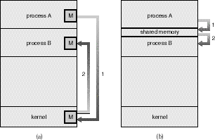
IPC models
There are two fundamental models of inter- process communication:
Shared Memory:
Message Passing.

Slide 21
Massage Passing
Communication takes place by means of messages exchanged between the cooperating processes.
Message passing is useful for exchanging smaller amounts of data, because no conflicts need be avoided. Message passing is also easier to implement than shared memory for inter-computer communication.

Slide 22
Shared Memory
A region of memory that is shared by cooperating processes is established. Processes can then exchange information by reading and writing data to the shared region.
Shared memory allows maximum speed and convenience of communication, as it can be done at memory speeds when within a computer.
Shared memory is faster than message passing, as message-passing systems are typically implemented using system calls and thus require the more time- consuming task of kernel intervention.

Slide 23
Massage passing Vs Sharing Memory
In contrast, in shared-memory systems, system calls are required only to establish shared-memory regions. Once shared memory is established, all accesses are treated as routine memory accesses, and no assistance from the kernel is required.

Slide 24
Process Synchronization
Synchronization is often necessary when processes communicate.
Processes are executed with unpredictable speeds. One can view synchronization as a set of constraints on the ordering of events.
The programmer employs a synchronization mechanism to delay execution of a process in order to satisfy such constraints.
As an illustrative example, consider the batch operating system again. A shared buffer is used for communication between the reader process and the writer process. These processes must be synchronized so that, for example, the reader process never attempts to read data from the input if the buffer is empty.

Slide 25
Race Condition
Situation where two or more processes are reading or writing some shared data and the final result depends on who run
precisely, are called race conditions

Slide 26
Race Condition?
Possibilities of race:
one process reading and another process writing same data.
two or more process writing same data.
Solution: prohibiting more than one process from reading /writing the same data at the same time- Mutual Exclusion or (next slide).

Slide 27
Solution to Race condition
Make an operating system not to perform several tasks in parallel. This is called serialization. Two strategies to serializing processes in a multitasking environment:
The Scheduler can be disabled
A Protocol can be introduced
Scheduler can be disabled for a short period of time, to prevent control being given to another process during a critical action like modifying shared data. This will be inefficient on multiprocessor machines, since all other processors have to be halted every time one wishes to execute a critical section.
A protocol can be introduced which all programs sharing data must obey. The protocol ensures that processes have to queue up to gain access to shared data.

Slide 28
Then what is Mutual Exclusion really?
Some way of making sure that if one process is using a shared variables or files, the other process will be excluded from doing the same thing.

Slide 29
Critical-Section
Code executed by the process can be grouped into sections, some of which require access to shared resources, and other that do not.
The section of the code that require access to shared resources are called critical section.
Facts: The part of the time, process is busy doing internal computations and other things that do not lead to the race condition. Non critical section
Helpful to avoid race condition.

Slide 30
Critical-Section Problem
When a process is accessing a shared modifiable data, the process is
said to be in critical section.
All other processes (those access the same data) are excluded from their own critical region.
All other processes may continue executing outside their CR.
When a process leaves its critical section, then another processes
waiting to enter its own CR should be allowed to proceed.

Slide 31
Critical-Section Problem
The critical section problem is to design a
protocol that the processes can use to co-operate.
A good solution to critical section problem must satisfy the following three requirements.
No two processes may be simultaneously inside their CRs (mutual exclusion).
No process running outside its CR may block other process.(Progress)
No process should have to wait forever to enter its CR.(Bounded Waiting)

Slide 32
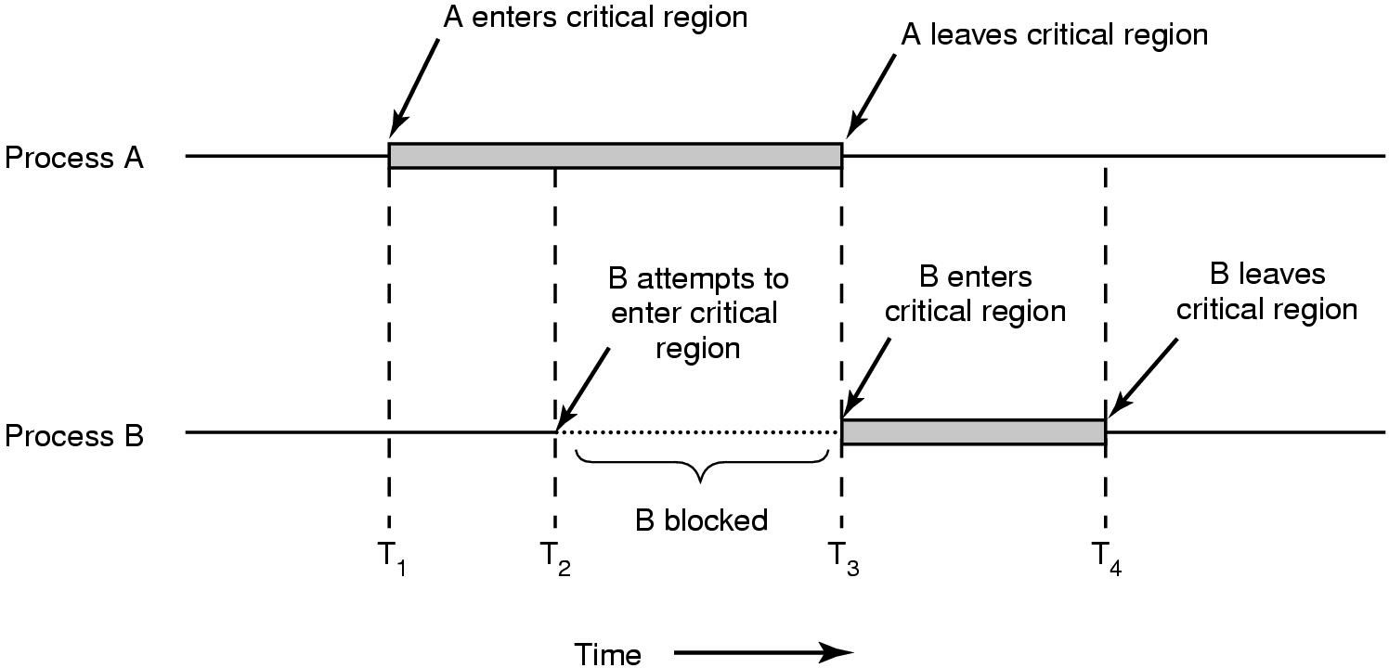
Critical Section diagram (with mutual exclusion)

Slide 33
Solution 1(Busy waiting) Interrupt Disabling
Each process disable all interrupts just after entering its CR
and re-enable them just before leaving it.
No clock interrupt, no other interrupt, no CPU switching to other process until the process turn on (enable) the interrupt.
The general structure of process may be as
Do
{
DisableInterrupt()
// perform CR task EnableInterrupt()
//perform Remiander section task
}while(1);

Slide 34
Facts about Disabling Interrupts
Advantages:
Mutual exclusion can be achieved by implementing OS primitives to disable and enable interrupt.
Problems:
allow the power of interrupt handling to the user.
The chances of never turned on is a disaster.
it only works in single processor environment.

Slide 35
Solution 2(Busy waiting) Lock Variables
A single, shared (lock) variable, initially 0.
When a process wants to enter its CR, it first test the lock. If the lock is 0, the process set it to 1 and enters the CR. If the lock is already 1, the process just waits until it becomes 0.
The general structure of process is
Do{
While(lock!=0); //busy waiting
Lock=1;
//perform the CR task Lock=0
//perform Non CR task
}while(true)

Slide 36
Facts
Advantages: seems no problems.
Problems:
problem like spooler directory;
suppose that one process reads the lock and sees that it is 0, before it can set lock to 1, another process scheduled, enter the CR, set lock to 1 and can have two process at CR (violates mutual exclusion)

Slide 37
Strict Alternation
Processes share a common integer variable
turn.
If turn == i
Then process Pi is allowed to execute in its CR,
if turn == j
then process Pj is allowed to execute.

Slide 38
While (true){ while(turn!=i); /*loop*/
critical_section();
turn = j;
noncritical_section
}
While (true){ while(turn!=j); /*loop*/
critical_section();
turn = i;
noncritical_section
}
Structure of Process Pi
Structure of Process Pj

Slide 39
Facts
Ensures that only one process at a time can be in its CR.
Problems: strict alternation of processes in the execution of the CR.
– What happens if process i just finished CR and again need to enter CR and the process j is still busy at non-CR work? (violate condition 2)

Slide 40
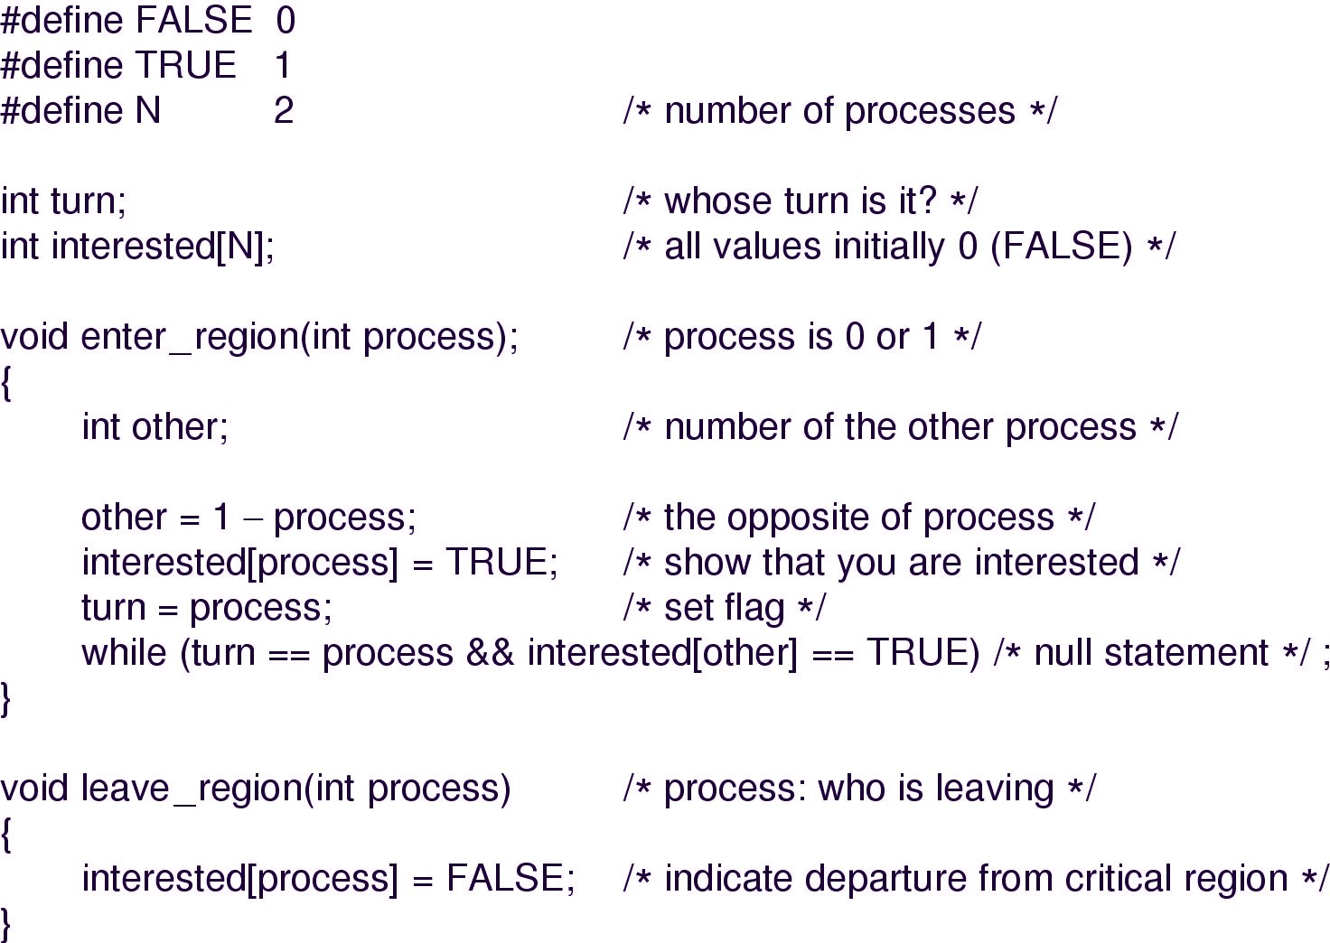
Peterson’s solution

Slide 41
Facts about Petersons
Before entering its CR, each process call enter_region with its own process number, 0 or 1 as parameter.
Call will cause to wait, if need be, until it is safe to enter.
When leaving CR, the process calls leave_region to indicate that it is done and to allow other process to enter CR.
Advantages: Preserves all conditions.
Problems: difficult to program for n-processes system and less efficient.

Slide 42
Hardware Assistance(TSL)
Checking for mutual exclusion is also possible through Hardware.
Specific instruction called Test and Set Lock(TSL) is used for this purpose.
The special properties of these instruction is that they cant be interrupted i.e. they are atomic instruction and carried out with out interruption.

Slide 43
TSL instruction
Test and Set Lock (TSL) instruction reads the contents of the memory word lock (shared variable) into the register and then stores nonzero value at the memory address lock.
This automatically as in a un-interruptible time unit.
The CPU executing TSL locks the memory bus to prohibit other CPUs from accessing memory until it is done.
When lock is 0, any process may set it to 1 using the TSL instruction.
When it is done the process lock back to 0.

Slide 44
Alternate to Busy waiting
Busy waiting:
When a process want to enter its CR, it checks to see if the entry is allowed, if it is not, the process
just sits in a tight loop waiting until it is.
Waste of CPU time for NOTHING!
Possibility of Sleep and Wakeup pair instead of waiting.
Sleep causes to caller to block, until another process wakes it up.

Slide 45
Sleep and week up Consumer Producer problem
Two process share a common, fixed sized buffer.
Suppose one process, producer, is generating information that the second process, consumer, is using.
– Their speed may be mismatched, if producer insert item rapidly the buffer will full and go to the sleep until consumer consumes some item, while consumer consumes rapidly, the buffer will empty and go to sleep until producer put something in the buffer.

Slide 46
Conti.
#define N = 100 /* number of slots in the buffer*/ int count = 0; /* number of item in the buffer*/
void producer(void)
{
int item; while(TRUE)
{ /* repeat forever*/
item = produce_item(); /*generate next item*/
if (count == N)
sleep(); /*if buffer is full go to sleep*/ insert_item(item); /* put item in buffer */ count = count +1; /*increment count */
if (count == 1) wakeup(consumer);
/* was buffer empty*/
}
47

Slide 48
Cont……
void consumer(void)
{
int item; while(TRUE)
{ /* repeat forever*/
if(count == 0)
sleep(); /* if buffer is empty go to sleep*/
item = remove_item(); /*take item out of buffer*/ count = count -1; /*decrement count*/
if (count == N-1)
wakeup(producer); /*was buffer full ?*/ consume_item(); /*print item*/
}
}

Slide 49
Producer Consumer with weak up and sleep signals
Problem:
leads to race as in Lock variable.
What happen if
When the buffer is empty, the consumer just reads count and quantum is expired, the producer inserts an item in the buffer, increments count and wake up consumer.
The consumer not yet asleep, so the wakeup signal is lost, the consumer has the count value 0 from the last read so go to the sleep.
Producer keeps on producing and fill the buffer and go to sleep,
both will sleep forever.
Think: If we were able to save the wakeup signal that was lost........(semaphores)

Slide 50
Semaphores
E. W. Dijkstra (1965) suggested using an integer variable to count
the number of wakeups, called a semaphore.
It could have the value 0, indicating no wakeups ware saved, or some positive value if one or more wakeups were pending.
Operations: Down and Up (originally he proposed P and V in Dutch and sometimes known as wait and signal)
Down: checks if the value greater than 0
yes- decrement the value (i.e. Uses one stored wakeup) and continues.
No- process is put to sleep without completing down.
Checking value, changing it, and possibly going to sleep, is all done as single action.
Up: increments the value; if one or more processes were sleeping, unable to complete earlier down operation, one of them is chosen and is allowed to complete its down.

Slide 51
Semaphore Operations
void down(S)
{
if(S> 0)
S--;
else
sleep(); //wait until s>0
}
void up (S)
{
if(one or more processes are sleeping on S) one of these process is proceed;
else
S++;
}
Notes:
Mutex: Mutual Exclusion.

Slide 52
Semaphore: Discussions
To avoid busy waiting, a semaphore may have an associated waiting queue of process.
If process does a down operation on a semaphore which is zero, the process is added to the semaphore’s queue.
When another process increments the semaphore by doing up operation and there are task in the queue, one is taken off and resumed.

Slide 53
Consumer producer using Semaphore
#define N 100 /*number of slots in buffer*/ typedef int semaphore; /*defining semaphore*/
semaphore mutex = 1; /* control access to the CR */ semaphore empty = N /*counts empty buffer slots*/ semaphore full = 0; /counts full buffer slots*/
void producer(void)
{
int item;
while(TRUE){ /*repeat forever */
item = produce_item(); /*generate something */ down(empty); /*decrement empty count*/ down(mutex); /*enter CR */
insert_item(); /* put new item in buffer*/ up(mutex); /* leave CR*/
up(full); /*increment co_{B}u_{y A}n_{s}t_{st}o_{. P}f_{ro}f_{f}u_{. T}l_{e}l_{j} s_{B}l_{a}o_{ha}t_{d}s_{u}*_{r}/_{Shahi}
53
}

Slide 54
Consumer producer using Semaphore
void consumer(void)
{
int item;
while(TRUE){ /*repeat forever*/ down(full); /*decrement full count */ down(mutex); /*enter CR*/
item = remove_item(); /*take item from buffer*/
up(mutex); /*leave CR*/
up(empty); /*increment count of empty slots*/ consume_item(); /*print item*/
}
}

Slide 55
Semaphore’s attraction
The have the following attractive properties
Machine independent
Simple
Powerful: provide exclusion and waiting
Work with many process
Can ask for many resources simultaneously with multiple down operations

Slide 56
Message Passing
With the trend of distributed operating system, many OS are used to
communicate through Internet, intranet, remote data processing etc.
Inter process communication based on two primitives operations:
send
and receive.
The general syntax for these operations looks like
send(destination, &message);
receive(source, &message);
The send and receive calls are normally implemented as operating system calls accessible from many programming language environments.

Slide 57
Producer-Consumer with Message Passing
#define N 100 /*number of slots in the buffer*/
void producer(void)
{ int item;
message m; /*message buffer*/ while (TRUE){
item = produce_item(); /*generate something */ receive(consumer, &m); /*wait for an empty to arrive*/ build_message(&m, item); /*construct a message to send*/ send(consumer, &m); }
}
void consumer(void)
{ int item; message m;
for(i = 0; i<N; i++) send(producer, &m); /*send N empties*/
while(TRUE){
receive(producer, &m); /* get message containing item*/ item = extract_item(&m); /* extract item from message*/ send(producer, &m); /* send back empty reply*/ consume_item(item); /*do some^{B}t^{y}h^{A}in^{ss}g^{t.} w^{Pro}it^{f.}h^{Te}i^{j}te^{B}m^{ah}*^{ad}/^{ur Shahi}
}
57

Slide 58
Message passing
No shared memory.
Messages sent but not yet received are buffered automatically by OS, it can save N messages.
The total number of messages in the system remains constant, so
they can be stored in given amount of memory known in advance.
Implementing Message Passing can be with:
Direct addressing: provide ID of destination.
Indirect addressing: Send to a mailbox.
Mail box: It is a message queue that can share by multiple senders and receivers, senders sends the message to the mailbox while the receiver pick ups the message from the mailbox.

Slide 59
Monitors
Higher level synchronization primitive.
A monitor is a programming language construct that guarantees appropriate access to the CR.
It is a collection of procedures, variables , and data structures that are all grouped together in a special kinds of module or package.
Processes that wish to access the shared data, do through the execution of monitor functions.
Only one process can be active in a monitor at any instant.

Slide 60
Monitors: discussion
A procedure defined with in a monitor can access only those variables declared locally with in the monitors.
A monitor is an object or module intended to be used safely by more than one process.
The defining characteristic of a monitor is that its methods are executed with mutual exclusion.
That is, at each point in time, at most one process may be executing any of its methods. This mutual exclusion greatly simplifies reasoning about the implementation of monitors compared to reasoning about parallel code that updates a data structure.

Slide 61
The Syntax of Monitors
Monitor monitor_name
{
shared variable declarations; procedure p1(){ ..... }
procedure p2(){ .... }
.... .
procedure pn(){ ...}
{initialization code;}
}

Slide 62
Classical IPC Problems

Slide 63

Dining Philosopher Problem
•Five Philosophers seated around the circular table
Each has a plate of Spaghetti
Each needs two forks to eat it
Between each pair of plates there is one fork

Slide 64
Dining Philosopher Problem
•The lives of the philosophers consist of two things- eat and think
•When a philosopher is hungry, she tries to acquire her left/ right fork, one at a time, in either order
•She only eats after successful acquisition of the forks
•She eats for a while and then puts them back to think

Slide 65
Dining Philosopher Problem
•Is it possible to have a solution so that no philosophers will be annoyed? (when her turn is eating, she eats; when her turn is thinking, she thinks)

Slide 66
Solutions
•Philosopher will wait until its
desired fork is available
•She will grab it when it’s available
•What if all the five philosophers take their left forks simultaneously?
•None will be able to take their right forks; there will be deadlock

Slide 67
Solutions
•After taking the left fork, philosopher will check if its right fork is available
•If it’s not, philosopher puts back her left fork, wait for some times and proceeds again in similar way
•What if all philosophers start simultaneously?
•They will never find their right fork available causing starvation

Slide 68
Solutions
•Using random start timer can solve this problem, but not ultimately

Slide 69
Solutions
•Well, there is a solution that will stop deadlock and starvation
•When philosopher wants to acquire a fork, she downs mutex; when she releases, she ups mutex
•The only drawback is only 1 of 5 philosophers can eat at a time though there is a best chance of 2 philosophers eating at same time

Slide 70
Solutions
•Our last solution will be deadlock free and achieve maximum parallelism.
•A philosopher will have 3 states- eating, thinking, or hungry (trying to acquire forks)
•A philosopher will move to eating state only if none of the neighbors is eating
•Only need is that each philosopher will have individual semaphores

Slide 71
The Readers-Writers Problem
•Dining philosopher problem defines the situation where processes compete for limited resources
•The Readers-Writers problem defines the situation where database access is required.
•A reader reads… the writer writes… but the reader is away and with an old value from the database: simply, this is the readers-writers problem

Slide 72
Solutions
•When a reader comes along, it UPs a semaphore- means, hey, we are reading, do not disturb
•If a writer comes, then it has to wait.
•If more readers come, they are allowed
•If reader comes along and along the writer just sits duck.

Slide 73
Solution
•When an active reader is reading, then a writer comes.
•It sees that a reader is reading, the writer then waits
•If more reader comes, they are queued
•When the active reader finishes, the writer takes place its schedule
•After finishing of writer, the queued readers are given chances.
•Concurrency problem and lower performance is key issue here

Slide 74
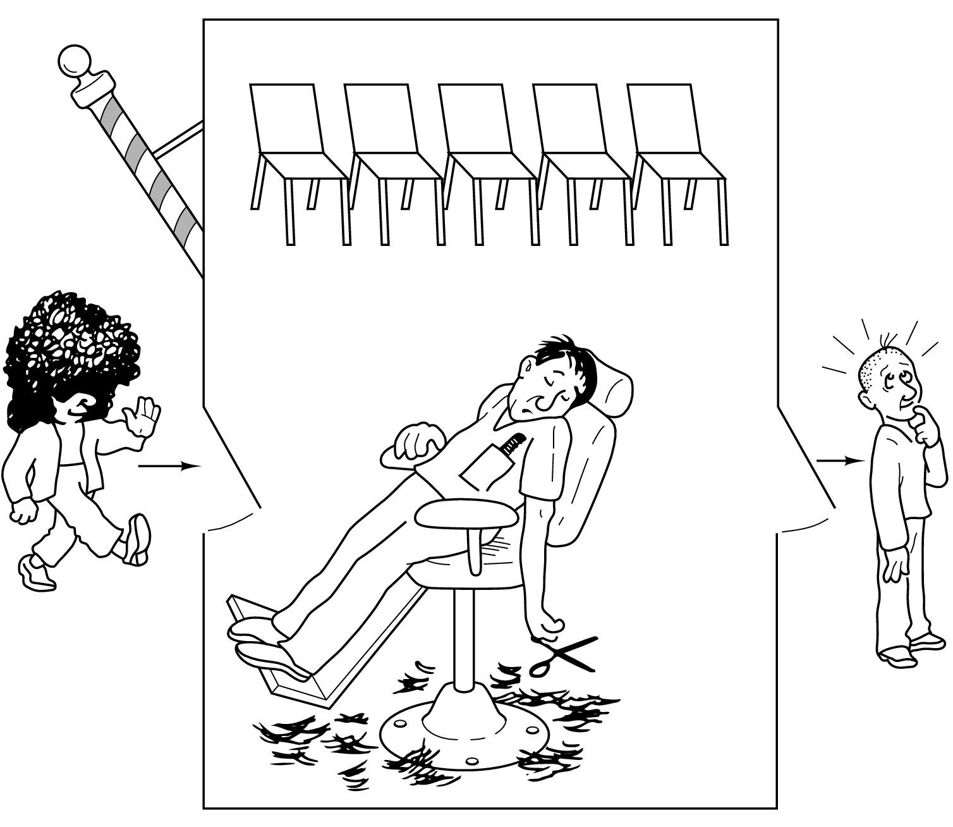
The Sleeping Barber Problem
In a barber shop, there is one barber, some chairs and some customers
A barber sleeps if there is no customer (not even on chairs, waiting for a haircut Λ)
A customer wakes up the barber if it’s his turn to get his haircut
A customer waits if there is any chair left
A customer leaves, if all the chairs are occupied

Slide 75
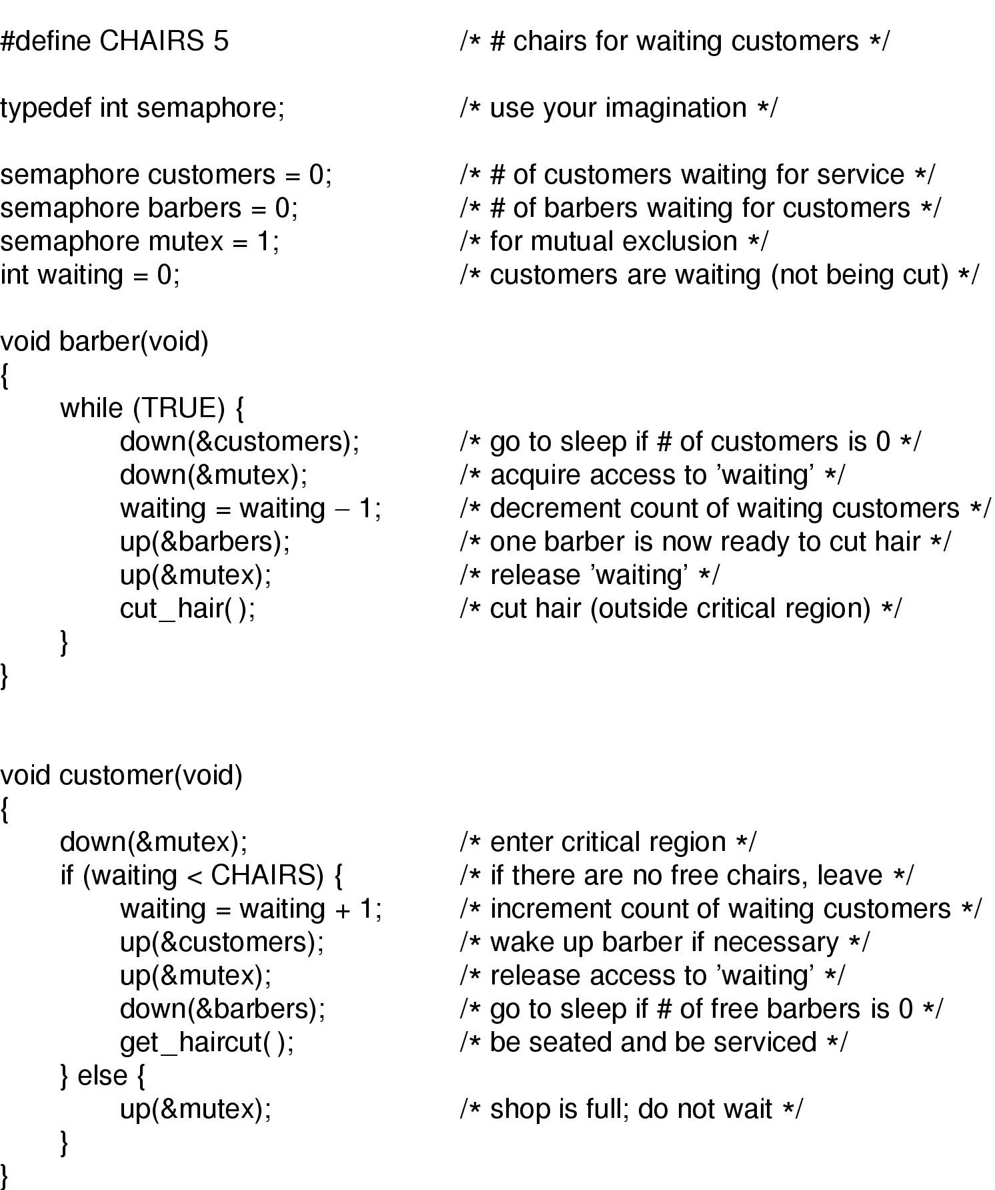
Solution
Rushdi Shams, Dept of CSE, KUET 49

Slide 76
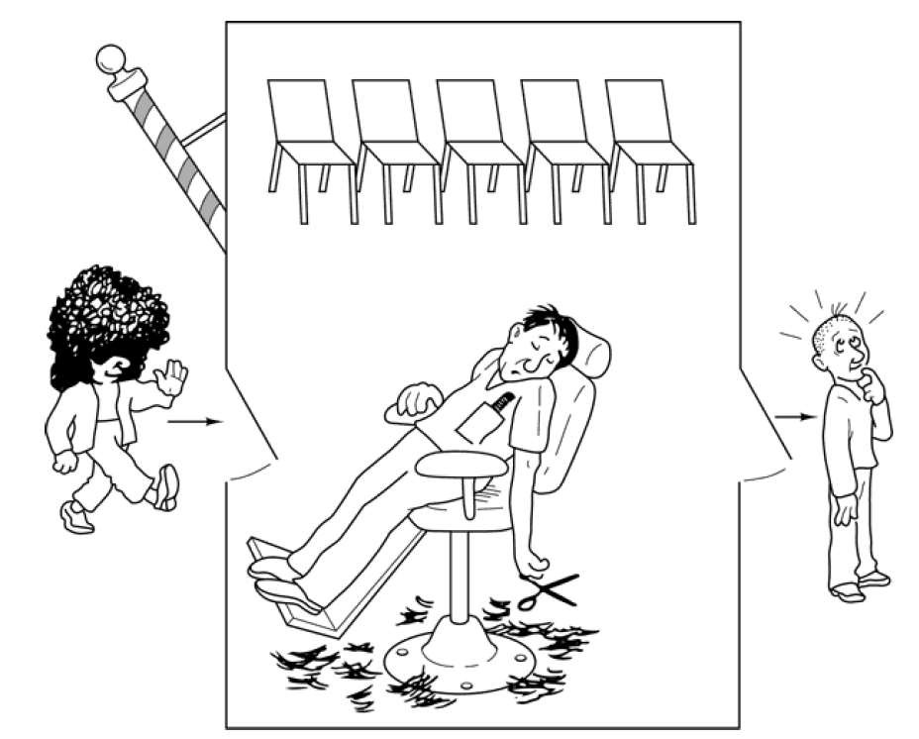
Sleeping Barber problem

Slide 77


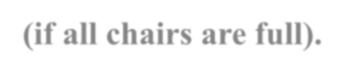
Sleeping Barber problem
Another classical IPC problem takes place in a barber shop.
The barber shop has one barber, one barber chair, and n chairs for waiting customers, if any, to sit on.
If there are no customers present, the barber sits down in the barber chair and falls asleep, as shown in the figure in the previous slide
When a customer arrives, he has to wake up the sleeping barber. If additional customers arrive while the barber is cutting a customer’s hair, they either sit down (if there are empty chairs) or leave the shop (if all chairs are full).

Slide 78
Sleeping Barber problem
Our solution uses three semaphores:
customers , which counts waiting customers (excluding the customer in the barber chair, who
is not waiting),
barbers , no. of barbers (0 or 1) based on barber is idle/waiting for customers,
mutex , which is used for mutual exclusion.
We also need a variable, waiting , which also counts the waiting customers. It is essentially a copy of customers .
The reason for having waiting is that there is no way to read the current value of a semaphore.
In this solution, a customer entering the shop has to count the number of waiting
customers. If it is less than the number of chairs, he stays; otherwise, he leaves.

Slide 79
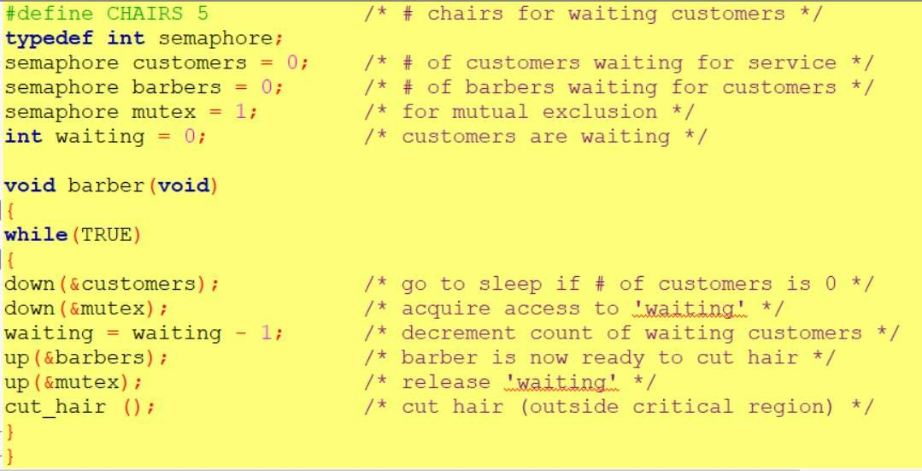
Sleeping Barber problem

Slide 80
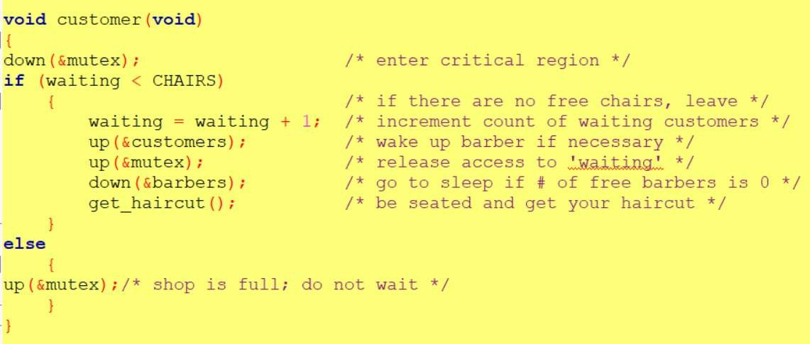
Sleeping Barber problem

Slide 81
Sleeping Barber problem
When the barber shows up for work in the morning, he executes the procedure barber, causing him to block on the semaphore customers because it is initially 0.
The barber then goes to sleep. He stays asleep until the first customer shows up.
When a customer arrives, he executes customer , starting by acquiring mutex
to enter a critical region.
If another customer enters shortly thereafter, the second one will not be able to do anything until the first one has released mutex . The customer then checks to see if the number of waiting customers is less than the number of chairs.
If not, he releases mutex and leaves without a haircut.

Slide 82
Sleeping Barber problem
If there is an available chair, the customer increments the integer variable, waiting .
Then he does an up on the semaphore customers , thus waking up the barber.
At this point, the customer and barber are both awake.
When the customer releases mutex , the barber grabs it, does some housekeeping, and begins the haircut.
When the haircut is over, the customer exits the procedure and leaves the shop.

Slide 83
Deadlock
A process in a multiprogramming system is said to be in dead lock if it is waiting for a particular
event that will never occur.

Slide 84
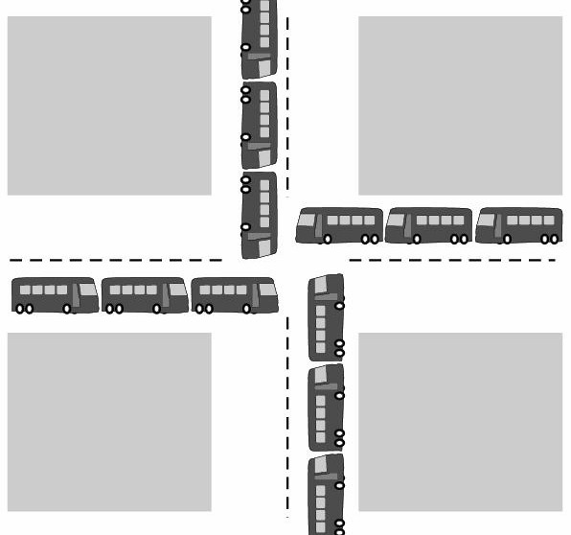
Deadlock Example
All automobiles trying to cross.
•Traffic Completely stopped.
•Not possible without backing some.

Slide 85
Resource Deadlock
A process request a resource before using it, and release after using it.
Request the resource.
Use the resource.
Release the resource.
If the resource is not available when it is requested, the requesting process is force to wait.
Most deadlocks in OS developed because of the normal contention for dedicated resources.

Slide 86
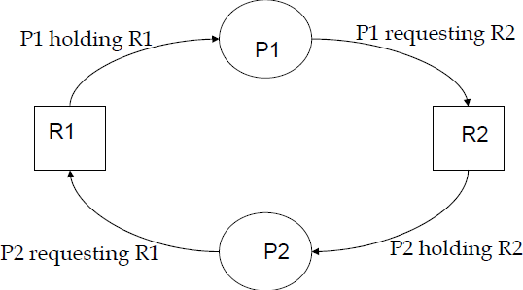
Resource Deadlock
Process P1 holds resource R1 and needs resource R2 to continue; Process P2 holds resource R2 and needs resource R1 to continue
–deadlock.
Key: Circular wait -deadlock

Slide 87
Resources
Resources come in two flavors: preemptable and no preemptable.
A preemptable resource is one that can be taken away from the process with no ill effects.
Memory is an example of a preemptable resource.
A no preemptable resource is one that cannot be taken away from the process (without causing ill effect). For example, CD resources are not preemptable at an arbitrary moment.

Slide 88
Condition for Deadlock
Mutual Exclusion: Process claims exclusive control of resources they require.
At least one resource must be held in a non-shareable mode, that is, only one process at a time claims exclusive control of the resource.
If another process requests that resource, the requesting process must be delayed until the resource has been released.

Slide 89
Condition for Deadlock
Hold and Wait: Processes hold resources already allocated to them while waiting for additional resources.
There must exist a process that is holding a resource already allocated to it while waiting for an additional resource that is currently being held by other processes.

Slide 90
Condition for Deadlock
No preemption: Resources previously granted can not be forcibly (or compulsorily) taken away from the process.
Resources cannot be removed from the processes are used to completion or released voluntarily by the process holding it.

Slide 91
Condition for Deadlock
Circular wait: Each process holds one or more resources that are requested by next process in the chain.
The processes in the system form a circular list or chain where each process in the list is waiting for a resource held by the next process in the list. There exists a set {P0, P1, …, P0} of waiting processes such that P0 is waiting for a resource that is held by P1, P1 is waiting for a resource that is held by P2, …, Pn–1 is waiting for a resource that is held by Pn, and P0 is waiting for a resource that is held by P0.

Slide 92
Resource Allocation Graph(RAG)
Deadlock can be described more precisely in terms of a directed graph called a system resource-allocation graph.
It Consist of Set of vertices and set of edges.
The set of vertices V is partitioned into two types of nodes:
P={p1,p2,…….pn}, the set of process in the system.
R={R1, R2, R3,……..Rn}, the set of resource types in the system.

Slide 93
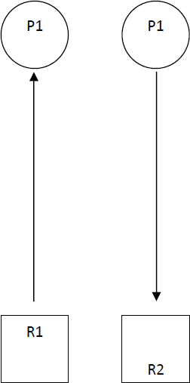
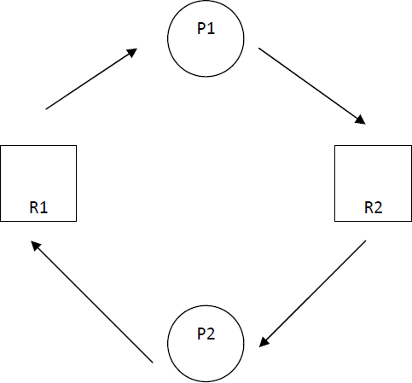
Example

Slide 94
Method for Handling Deadlock
We can use a protocol to prevent or avoid deadlocks, ensuring that the system never enter a deadlock state.
We can allow the system to enter a deadlock state, detect it, and recover.
We can ignore the problem all to gather, and pretended that deadlock never occur in the system.

Slide 95
Deadlock Prevention
Idea: If any one of the four necessary conditions is denied, a deadlock can not occur.
By implementing policy that makes one of the conditions impossible, the system will be
assured to be deadlock free.

Slide 96
First : Denying Mutual Exclusion
Sharable resources do not require mutually exclusive access such as read only shared file.
But!!! Some resources are strictly non-sharable, mutually exclusive control required.
So We can not prevent deadlock by denying the mutual exclusion

Slide 97
Second: Denying Hold and Wait:
Policy:
Resources grant on all or none basis;
If all resources needed for processing are available then granted and allowed to process.
If complete set of resources is not available, the process
must wait set available.
While waiting, the process should not hold any resources.
Problem:
Low resource utilization.
Starvation is possible. A process that needs several popular resources may have to wait indefinitely, because at least one of the resources that it needs is always allocated to some other process.

Slide 98
Third: Denying No-preemption
policy
When a process holding resources is denied a request for additional resources, that process must release its held resources and if necessary, request them again together with additional resources.
Problem:
When process releases resources the process may loose all its works to that point .

Slide 99
Denying Circular Wait:
Policy
All resources are uniquely numbered, and processes must request resources in linear ascending order.
The only ascending order prevents the circular wait .
Problem:
Difficult to maintain the resource order; dynamic update in addition of new resources.

Slide 100
Deadlock Avoidance
Deadlock-prevention algorithms ensure that at least one of the necessary
conditions for deadlock cannot occur and hence that deadlocks cannot hold. Possible side effects of preventing deadlocks are low device utilization and reduced system throughput.
Alternative
For example, in a system with one tape drive and one printer, the system might need to know that process P will request first the tape drive and then the printer before releasing both resources, whereas process Q will request first the printer and then the tape drive.
Assign resource that leads to the system into safe state.

Slide 101
Deadlock Avoidance
Each request requires that in making this decision the
system consider:
the resources currently available,
the resources currently allocated to each process,
the future requests and releases of each process.
Initially the system is in safe state. Whenever a process request resource that is currently available, the system
must decide whether the resource can be allocated
immediately or whether the process must wait.

Slide 102
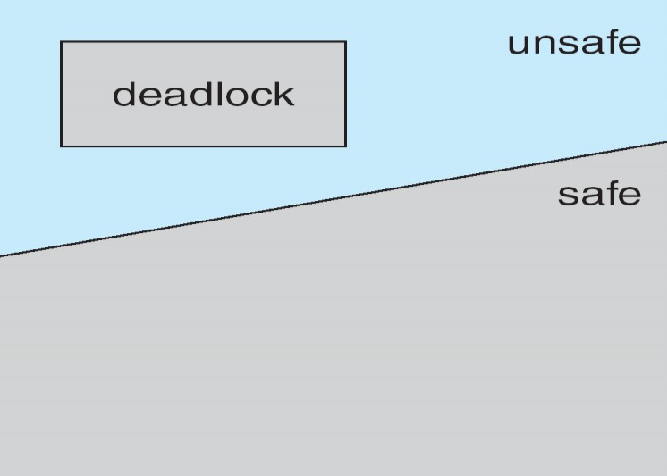
Safe state and Deadlock State
If a system is in a safe state ⇒No deadlocks.
If a system is in unsafe state ⇒Possibility of deadlock.
Avoidance ⇒ensure that a system will never reach an unsafe state.

Slide 103
Example
A state is said to be safe if it is not deadlocked and there is a some scheduling order in which every process can run to completion.
To illustrate, we consider a system with 12 magnetic tape drives and three processes:
Process | Max | Has
P1 | 10 | 5
P2 | 4 | 2
P3 | 9 | 2
Thus, there are 3 free tape drives.

Slide 104
Continued
At time t₀, the system is in a safe state. The sequence
<p2,p1,p3> satisfies the safety condition.
A system can go from a safe state to an unsafe state. Suppose that, at time t1 , process p3 requests and is allocated one more tape drive. The system is no longer in a safe state.
Our mistake was in granting the request from process p3 for one more tape drive.
Processes | Max. | Has
P1 | 10 | 5
P2 | 4 | 2
P3 | 9 | 2+1

Slide 105
Deadlock Avoidance
Banker’s Algorithm
Models on the way of banking system to ensure that the bank never allocates its available cash such that it can no longer satisfy the needs of all its customers.
When a process request the set of resources, the system determine whether the allocation of these resources will left the system in safe state, if it will the resources are allocated, otherwise process must wait until some other process release enough resources.
Data structures: Available, Max, Allocation & Need.
need = max –allocation.

Slide 106
Banker’s Algorithm
If a process is requesting more resource than its need, then raise an
error
If request is valid, the number of resources requested is compared to the number of available resources.
If not enough resources are available, the request is denied and the
process must wait.
If sufficient resources are available, the modified version of the current state is created that reflect the effect of granting request. The algorithm then checks if the modified version of the system is safe.
The resource is granted if and only if the modified version of the system state is safe.
It ensure that the system is never in unsafe state. so it avoid the deadlock

Slide 107
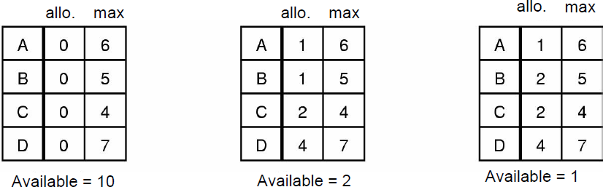
Banker’s Algorithm
Which one is unsafe?

Slide 108
Deadlock Avoidance Problem with Banker
Algorithms requires fixed number of resources, some processes dynamically changes the number of resources.
Algorithms requires the number of resources in advanced, it is very difficult to predict the resources in advanced.
Algorithms predict all process returns within finite time, but the system does not guarantee it.

Slide 109
Deadlock Detection and Recovery
Instead of trying to prevent or avoid deadlock, system allow to deadlock to happen,
and recover from deadlock when it does occur.
Hence, the mechanism for deadlock detection and recovery from deadlock required.

Slide 110
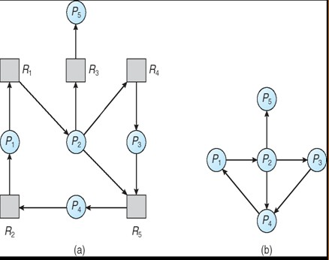
Deadlock Detection
If all resource have only a single instance, then we can define a deadlock detection algorithm that use a variant of resource allocation graph, called wait for graph.
Example

Slide 111
Example
Consider the following scenario:
A system with 7 processes (A –G), and 6 resources (R –W) are in following state.
Process A holds R and S.
Process B holds nothing but wants T.
Process C holds nothing but wants S.
Process D holds U and wants S and T.
Process E holds T and wants V.
Process F holds W and wants S.
Process G holds V and wants U.
Is there any deadlock situation?

Slide 112
Deadlock Detection
A deadlock exits in the system if and only if the wait for graph contains cycle.
To detect deadlock the system needs to maintain the wait for graph and periodically invoke an algorithm that searches for a cycle in the graph.
An algorithm to detect a cycle in graph requires an order of o(n²)

Slide 113
Recovery from Deadlock
What do next if the deadlock detection algorithm succeed? –recover from deadlock.
By Resource Preemption
Preempt some resources temporarily from a processes and give these resources to other processes until the deadlock cycle is broken.
Problem:
Depends on the resources.
Need extra manipulation to suspend the process.
Difficult and sometime impossible.

Slide 114
Recovery from Deadlock
By Process Termination
Eliminating deadlock by killing one or more process in cycle or process not in cycle.
Problem:
If the process was in the midst of updating file, terminating it will leave file in incorrect state.
Key idea: we should terminate those processes the termination of which incur the minimum cost.

Slide 115
Ostrich Algorithm
Fact: there is no good way of dealing with deadlock.
Ignore the problem altogether
For most operating systems, deadlock is a rare occurrence; So the problem of deadlock is ignored, like an ostrich sticking its head in the sand and hoping the problem will go away.

Slide 116
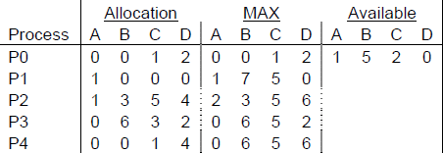
Exercise
Is it possible to have a deadlock involving only one process? Explain
Consider the following snapshot of a system (given bellow) Answer the following questions using Banker's algorithm:
What is the content of the matrix Need?
Is the system in a safe state?
If a request from process P1 arrives for (0,4,2,0), can the request be granted immediately ?

Slide 117
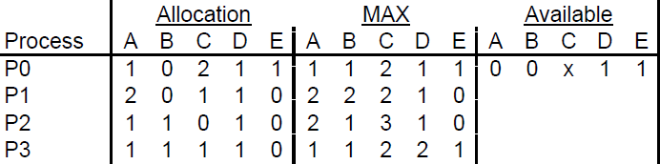
3. A system has four processes and five allocable resources. The
current allocation and maximum needs are given bellow:
– What is the smallest value of x for which this is a safe state based on the Banker’s algorithm?

Slide 118
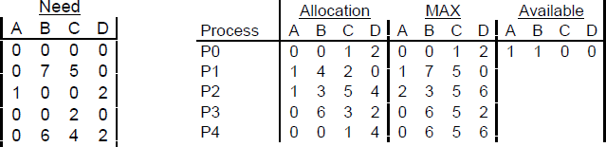
Solutions
1. No.
This follows directly from the hold and wait condition.
Hold and wait: a process holding at least one resource is waiting to acquire additional resources held by other processes
2.
Need = Max – Allocation. The matrix is shown bellow on the left-hand side;
Yes, a sequence <P3, P4, P2, P1, P0> is safe;
Yes, there is a sequence <P0, P2, P1, P4, P3> which is safe. The snapshot of the system after resources allocation is given bellow on the right-hand side.

Slide 119
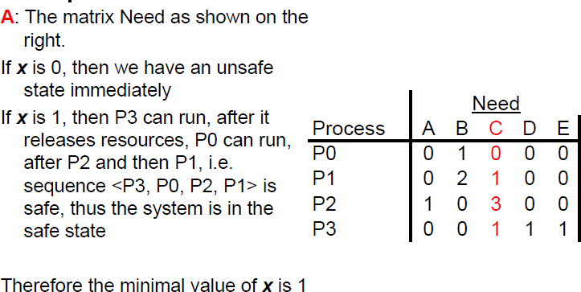
Solution for 3
18/04/2018
Tej Shahi
33

Slide 120
THREADS (OPERATING SYSTEM)

Slide 121
What is Thread ?
A thread is a flow of execution through the process code, with its own program counter, system registers and stack. A thread is also called a light weight process. Threads provide a way to improve application performance through parallelism.
Each thread belongs to exactly one process and no thread can exist outside a process.

Slide 122

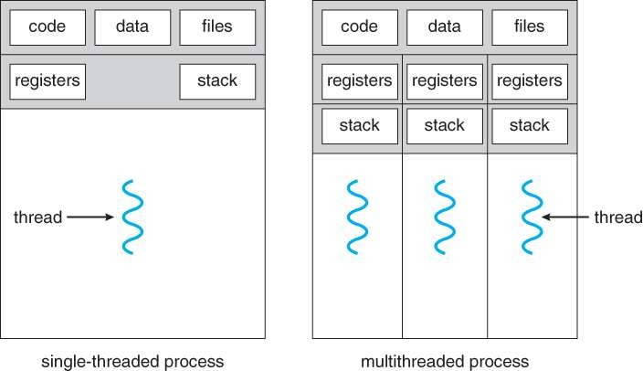
Single threaded Process and Multi-threaded Process

Slide 123
Difference between Process and Threads :
S.N. | Process | Threads
1. | Process is heavy weight or resource intensive. | Thread is light weight taking lesser resources than a process.
2. | Process switching needs interaction with operating system. | Thread switching does not need to interact with operating system.
3. | In multiple processing environments each process executes the same code but has its own memory and file resources. | All threads can share same set of open files, child processes.
4. | If one process is blocked then no other process can execute until the first process is unblocked. | While one thread is blocked and waiting, second thread in the same task can run.
5. | Multiple processes without using threads use more resources. | Multiple threaded processes use fewer resources.
6. | In multiple processes each process operates independently of the others. | One thread can read, write or change another thread's data.

Slide 124
Advantages of Threads :
Thread minimizes context switching time.
Use of threads provides concurrency within a process.
Efficient communication.
Economy- It is more economical to create and context switch threads.
Utilization of multiprocessor architectures to a greater scale and efficiency.

Slide 125
Disadvantages of Threads :
Blocking of parent threads will stop all child thread.
Security.

Slide 126
Types of Threads :
Threads are implemented in following two ways :
User Level Threads (ULT)
Kernel Level Threads (KLT)

Slide 127
User Level Threads (ULT) :
User level thread implement in user level libraries, so thread switching does not need to call operating system and to cause interrupt to the kernel.
In fact, the kernel knows nothing about user level threads and manages them as if they were single-threaded process.

Slide 128
Advantages of ULT :
User level threads does not require modification to operating system.
Easy to represent and manage.
User level thread can run on any operating system.
User level threads are fast and efficient.
Disadvantages of ULT :
There is a lack of coordination between threads and operating system kernel.
ULT require non-blocking system call (i.e. Multithreaded kernel)

Slide 129
Kernel Level Threads (KLT) :
In this method, the kernel knows about and manages the threads. No runtime system is needed in this case. Operating system kernel provides system call to create and manage threads.

Slide 130
Advantages of KLT :
Kernel can simultaneously schedule multiple threads from the same process on multiple processes.
If one thread in a process is blocked the kernel can schedule
another thread of the same process.
Kernel routines themselves can multithreaded.
Disadvantages of KLT :
Kernel thread are generally slower to create and manage than the user threads.
Kernel requires Thread Control Block (TCB) for each thread in the pool, hence complexity increases.

Slide 131
Difference between ULT and KLT :
S.N. | User Level Thread | Kernel Level Thread
1. | User level thread are faster to create and manage. | Kernel level thread are slower to create and manage.
2. | Implementation is by a thread library at the user level. | Operating system supports creation of kernel level threads.
3. | ULT is generic and can run on any operating system. | KLT is specific to the operating system.
4. | Multi-Threaded can not take advantages of multiprocessing. | Kernel routines themselves can be multithreaded.

Slide 132
Multi-Threading Models :
Some operating system provides a combined user level thread and kernel level thread facility. Solaris is a good example of this combined approch.
Multi-Threading models are three types.
Many-to-One Model
One-to-One Model
Many-to-Many Model

Slide 133
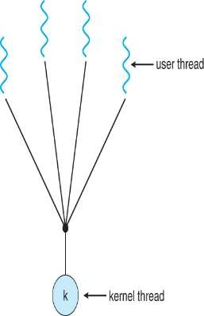
Many-to-One Model :
Implementation of the many-to-one model (many user level thread to one kernel level thread) allow the application to create any number of threads that can execute concurrently. In this implementation, all threads activity is restricted to user space.
Additionally only one thread can access the kernel at a time, so only one schedulable entity is known to the os.

Slide 134
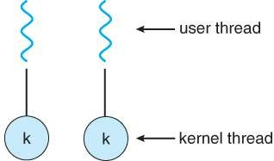
One-to-One Model :
The one-to-one model (one user level thread to one kernel level thread) is among the earliest implementations of true multithreading. In this implementation, each ULT created by the application is known to the kernel,and all threads ca access the kernel at the same time.

Slide 135
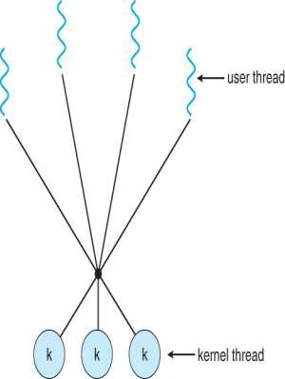
Many-to-Many Model :
The many-to-many model (many user level thread to many kernel level thread) avoids many of the limitations of the one-to-one model, while extending multithreading capabilities even further. The many- to-many model also called two-level model, minimize programing effort while reducing the cost and weight of each thread.

Slide 136

THANK YOU !
“

Slide 137
Homework 3
Discuss intercrosses communication in details
What is critical section and critical section problem?
What are semaphores? Explain.
What are monitors? Explains
Show the Peterson's algorithm preserve mutual exclusion, indefinite postponement and progress (deadlock)

